Slide 1

GAME ANALYSIS FRAMEWORKS
CHAPTER 02
‹#›

Slide 2
Topics
Common Frameworks for Ludology
MDA: Mechanics, Dynamics, and Aesthetics
Formal, Dramatic, and Dynamic Elements
Elemental Tetrad
‹#›

Slide 3
MDA: Mechanics, Dynamics, & Aesthetics
Proposed at the Game Developers Conference (2001)
Formalized in "MDA: A Formal Approach to Game Design and Game Research"
Robin Hunicke, Marc LeBlanc, Robert Zubek (2004)
Most well known framework for game analysis
Three elements:
Mechanics: The particular components of the game at the level of data representation and algorithms
Dynamics: The runtime behavior of the mechanics acting on player inputs and each other's outputs over time
Aesthetics: The desirable emotional responses evoked in the player when she interacts with the game system
‹#›

Slide 4

MDA: Mechanics, Dynamics, & Aesthetics
Designers and players view games from different directions
Designers first consider the aesthetic feelings that they want players to experience
Then consider the dynamic play that will engender these aesthetics
Finally create mechanics that will lead to these dynamics
Players first read the rules of the game (mechanics)
These rules lead to dynamic play
The dynamics engender aesthetic feeligns
‹#›

Slide 5
Formal, Dramatic, and Dynamic Elements
From Game Design Workshop by Tracy Fullerton
Formal elements: The elements that make games different from other forms of media or interaction and provide the structure of a game. Formal elements include things like rules, resources, and boundaries.
Dramatic elements: The story and narrative of the game, including the premise. Dramatic elements tie the game together, help players understand the rules, and encourage the player to become emotionally invested in the outcome of the game.
Dynamic elements: The game in motion. Once players turn the rules into actual gameplay, the game has moved into dynamic elements. Dynamic elements include things like strategy, behavior, and relationships between game entities.
‹#›

Slide 6
Formal, Dramatic, and Dynamic Elements
A game ceases to be a game if the formal elements are removed
Seven formal elements of games
1. Player interaction pattern: How do the players interact?
Single-player
One-on-one
Team versus team
Multilateral (multiple players versus each other)
Unilateral (one player versus all the other players)
Cooperative play
Multiple individual players each working against the same system
2. Objective: What are the players trying to achieve in the game? When has someone won the game?
‹#›

Slide 7
Formal, Dramatic, and Dynamic Elements
Seven formal elements of games
3. Rules: Limit the players' actions by telling them what they may and may not do in the game.
Many rules are explicit, but others are implicitly understood
4. Procedures: Actions taken by the players in the game
A rule tells the player what to do
The procedure dictated by that rule is the actual action of the player
Procedures are often defined by the interaction of a number of rules
Some procedures are also outside of the rules: Bluffing in Poker
5. Resources: Elements that have value in the game
Money
Health
Items
Property
‹#›

Slide 8
Formal, Dramatic, and Dynamic Elements
Seven formal elements of games
6. Boundaries: Where does the game end and reality begin?
"A game is a temporary world where the rules of the game apply rather than the rules of the ordinary world" – Johan Huizinga, Homo Ludens (1955)
This concept is now known as the Magic Circle
In a sport like football or ice hockey, the magic circle is defined by the boundaries of the playing field
In an Alternative Reality Game like I Love Bees (the ARG for Halo 2), the boundaries are more vague
7. Outcome: How did the game end?
Both final and incremental outcomes
In Chess, the final outcome is that one player will win, and the other will lose
In an RPG, there are several incremental outcomes
‹#›

Slide 9
Formal, Dramatic, and Dynamic Elements
Dramatic elements of games
Make the rules and resources more understandable
Give players greater emotional investment in the game
Three dramatic elements of games
1. Premise: The basic story of the game world
Monopoly: The players are real-estate developers trying to get a monopoly on corporate real estate in Atlantic City, New Jersey
Donkey Kong: The player is trying to single-handedly save his girlfriend from a gorilla that has kidnapped her
The premise forms the basis around which the rest of the game's narrative is built
‹#›

Slide 10
Formal, Dramatic, and Dynamic Elements
Three dramatic elements of games
2. Character: The individuals around whom the story revolves
Vary widely in depth
The main character of Quake is nameless and largely undefined
Nathan Drake, from the Uncharted games, is as deep and multidimensional as the lead characters in most movies
In movies, the goal of the director is to encourage the audience to have empathy for the film's protagonist
In games, the player actually is the protagonist character
Designers must choose whether the protagonist will act as
An avatar for the player
A role that the player must take on
Most common of the two
Much simpler to implement.
3. Story: The plot of the game
The narrative that takes place through the course of the game
‹#›

Slide 11
Formal, Dramatic, and Dynamic Elements
Dynamic elements of games
Occur only when the game is being played
Core concepts of dynamic elements
Emergence
Simple rules lead to complex and unpredictable behavior
One of a game designer's most important jobs is to attempt to understand the emergent implications of the rules in a game.
Emergent narrative
Narrative can also be dynamic
Narratives can emerge from the gameplay itself
One of the central appeals of RPGs like Dungeons & Dragons
Different from the narrative embedded in cut scenes and plot
Unique to interactive experiences.
‹#›

Slide 12
Formal, Dramatic, and Dynamic Elements
Core concepts of dynamic elements
Playtesting is the only way to understand dynamics
Game systems are unpredictable
Experienced game designers can make better guesses
But, everyone must playtest to understand a game
‹#›

Slide 13
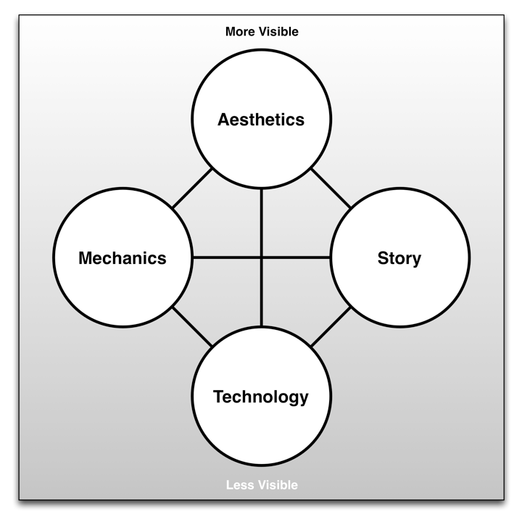
The Elemental Tetrad
From The Art of Game Design: A Book of Lenses by Jesse Schell
A tetrad of elements
‹#›

Slide 14
The Elemental Tetrad
Mechanics
Rules for interaction between the player and the game
Differentiate games from other non-interactive media
Contain
Rules
Objectives
Other Formal elements
Different from mechanics in MDA
Schell differentiates between mechanics and technology
‹#›

Slide 15
The Elemental Tetrad
Aesthetics
Describe how the game is perceived by the five senses
Vision
Sound
Smell
Taste
Touch
Many different aspects of aesthetics
Soundtrack
3D graphics and animation
Packaging and cover art
Different from aesthetics in MDA
MDA aesthetics describes the emotional response to the game
Schell's aesthetics describe the five senses
‹#›

Slide 16
The Elemental Tetrad
Technology
The underlying technology that makes the game work
Digital technologies
Computer and console hardware
Software and programming
Rendering software and pipelines
Paper technologies
Dice and other randomizers
Statistics tables
‹#›

Slide 17
The Elemental Tetrad
Story
Everything included in Fullerton's Dramatic Elements
Differs from Fullerton's Dramatic Elements because it is broader than what she terms story.
Schell's story includes premise and character as well
‹#›

Slide 18
The Elemental Tetrad
Schell arranges the elements in a tetrad
Four elements also represent four groups in a game studio
Arranged from most to least visible
‹#›

Slide 19
Chapter 2 – Summary
Each framework has a different perspective
MDA demonstrates that gamers and designers approach games from different directions
Encourages designers to see games from the perspective of players
Formal, Dramatic, & Dynamic breaks games down into specific components that can be isolated, tweaked, and improved
Elemental Tetrad views games from the perspective of a development studio
Next Chapter: The Layered Tetrad
The Layered Tetrad attempts to bring these schools of thought together into a more complete theory
‹#›

